Slide 1
Introduction to Software Engineering
CSSE3113

Slide 2
The Requirements Process
A requirement is an expression of desired behaviour
Requirements focus on the customer needs, not on the solution or implementation
designate what behaviour, without saying how that behaviour will be realized

Slide 3
The Requirements Process Sidebar: Why Are Requirements Important?
Top factors that caused project to fail
Incomplete requirements
Lack of user involvement
Unrealistic expectations
Lack of executive support
Changing requirements and specifications
Lack of planning
System no longer needed
Some part of the requirements process is involved in all of the causes
Requirements error can be expensive if not detected early

Slide 4
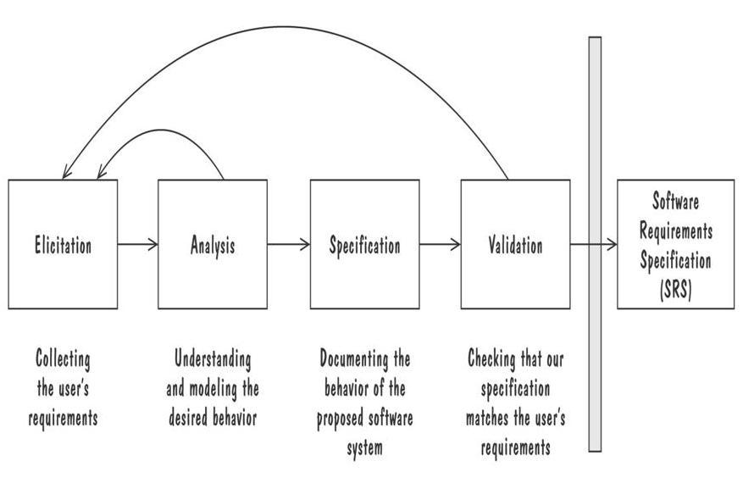
The Requirements Process
Performed by the req. analyst or system analyst
The final outcome is a Software Requirements Specification (SRS) document
Process for Capturing Requirements

Slide 5
Requirements Elicitation
Customers do not always understand what their needs and problems are
It is important to discuss the requirements with everyone who has a stake in the system
Come up with agreement on what the requirements are
If we cannot agree on what the requirements are, then the project is doomed to fail

Slide 6
Requirements Elicitation
Different Stakeholders are:
Clients: pay for the software to be developed
Customers: buy the software after it is developed
Users: use the system
Domain experts: familiar with the problem that the software must automate
Market Researchers: conduct surveys to determine future trends and potential customers
Lawyers or auditors: familiar with government, safety, or legal requirements
Software engineers or other technology experts

Slide 7
Requirements Elicitation
Means to Elicit Requirements:
Interviewing stake holders
Reviewing available documentations
Observing the current system (if one exists)
Apprenticing with users to learn about user's task in more details
Interviewing user or stakeholders in groups
Using domain specific strategies, such as Joint Application Design, or PIECES
Brainstorming with current and potential users

Slide 8
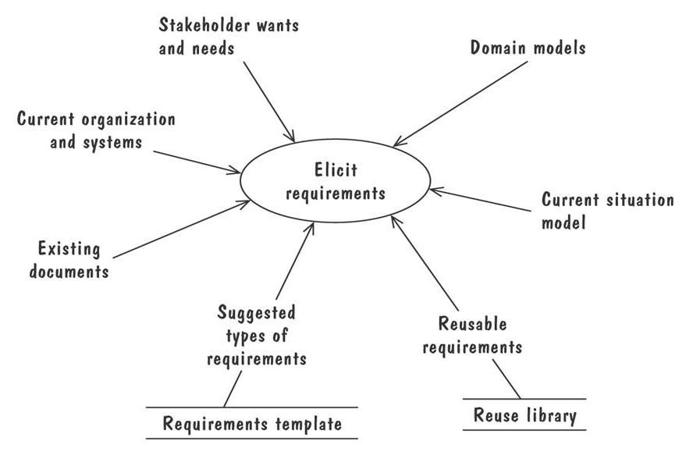
Requirements Elicitation
The Volere requirements process model suggests some additional sources for requirements

Slide 9
Types of Requirements
Functional requirement
Describes: interaction between the system and its environment, how should the system behave given certain stimuli, required behaviour in terms of required activities
Example: For a system of printing pay cheques the functional requirements must answer the following:
When are pay cheques issued?
What input is necessary for a pay cheque to be printed?
Quality requirement or non-functional requirement
Describes: some quality characteristic that the software must posses, a restriction on the system that limits our choices for constructing a solution
Constraints could be:
Design constraint: a design decision such as choice of platform or interface components
Process constraint: a restriction on the techniques or resources that can be used to build the system
Example: queries to the system must be answered within 3 seconds
Both types of requirements are elicited from the customer in a formal, careful way.

Slide 10
Types of Requirements
Two kinds of Requirement Documents
Requirements definition: a complete listing of everything the customer wants to achieve
Describing the entities in the environment where the system will be installed
Requirements specification: restates the requirements as a specification of how the proposed system shall behave
Primarily used by our technical team

Slide 11
Prioritizing Requirements
Different stakeholder has different set of requirements
potential conflicting ideas
Need to prioritize requirements to resolve conflicts
Prioritization might separate requirements into three categories
essential: absolutely must be met
desirable: highly desirable but not necessary
optional: possible but could be eliminated

Slide 12
Lecture

Slide 13
Characteristics of Requirements
Correct
Consistent
Unambiguous
Complete
Feasible
Relevant
Testable
Traceable

Slide 14
Testable Requirements
Testable/Measurable Requirement:
Objective description of the requirement’s meanings
All possible entities and activities can be examined and classified as Meet Requirements and Do Not Meet Requirements
Testable requirements are helpful in making good design
Requirements that are not testable are likely to be ambiguous, incomplete and incorrect

Slide 15
Testable Requirements
Robertson and Robertson suggest 3 ways to help make requirements testable:
Specify a quantitative description for each adverb and adjective
Replace pronouns with specific names of entities
Make sure that every noun is defined in exactly one place in the requirements document

Slide 16
Testable Requirements
Some examples:
Not Testable: Water quality information must be accessible immediately
Testable: Water quality information must be retrieved within five seconds of request
Not Testable: The system should handle a large number of users at a time
Testable: The system should handle 5000 users at a time
Not Testable: User should press the Save button when writing text in the system. This prevents it from being lost.
Testable: User should press the Save button when writing a note in the system. Pressing the Save button prevents the text from being lost.

Slide 17
Expressing Requirements
A requirement deals with
objects or entities
the state they can be in
functions that are performed to change states or object characteristics
It is important to have standard notations for modelling, documenting, and communicating decisions
Modelling helps us to understand requirements thoroughly
Holes in the models reveal unknown or ambiguous behaviour
Multiple, conflicting outputs to the same input reveal inconsistencies in the requirements

Slide 18
Expressing Requirements
Dynamic Descriptions of a System
Decision Tables
State Diagrams (Statecharts)
Fence Diagrams
Event Tables
Petri Nets
Event Traces (Message Sequence Charts)
Static Descriptions of a System
Object Models (ER Diagrams, Abstract class diagrams)
Other Techniques to Express Requirements
Data Flow Diagrams (DFD)
Usecase Diagrams

Slide 19
Decision Tables
It is a tabular representation of a functional specification that maps events and conditions to appropriate reponses or action
The specification is formal because the inputs (events and conditions) and outputs (actions) may be expressed in natural language
If there is n input conditions, there are 2^{n} possible combination of input conditions
Combinations map to the same set of result can be combined into a single column

Slide 20
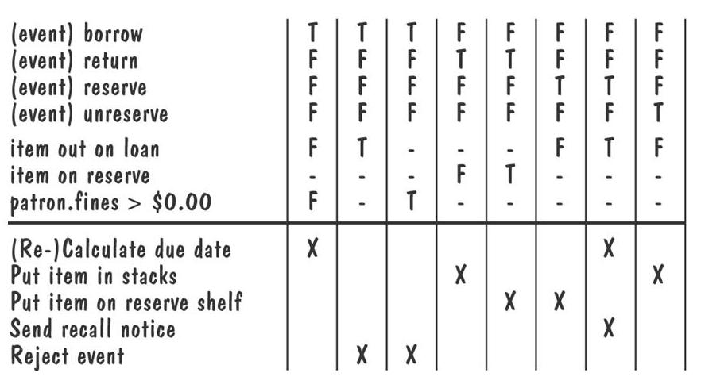
Decision Tables (Contd.)
Decision table for library functions borrow, return, reserve, and unreserve

Slide 21
State Diagrams
A graphical description of all dialog between the system and its environment
Node (state) represents a stable set of conditions that exists between event occurences
Edge (transition) represents a change in behavior or condition due to the occurrence of an event
Useful both for specifying dynamic behavior and for describing how behavior should change in response to the history of events that have already occurred

Slide 22
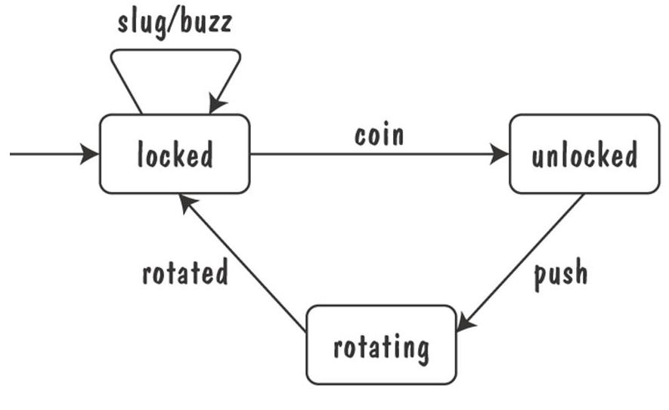
State Diagrams (Contd.)
Finite state machine model of the tunstile problem

Slide 23
State Diagrams (Contd.)
A path: starting from the machine's initial state and following transitions from state to state
A trace of observable events in the environment
Deterministic state machine: for every state and event there is a unique response

Slide 24
State Diagrams (Contd.)
Ways of thinking about State
Equivalence classes of possible future behavior
Periods of time between consecutive event
Named control points in an object's evolution
Partition of an object's behavior

Slide 25
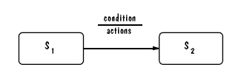
State Diagrams: UML Notation

Slide 26
State Diagrams: UML Statechart
A UML statechart diagram depicts the dynamic behaviour of the objects in a UML class
UML class diagram has no information about how the entities behave, how the behaviours change
A UML model is a collection of concurrently executing statecharts
UML statechart diagram have a rich syntax, including state hierarchy, concurrency, and inter-machine communication

Slide 27
UML Statechart Diagram
State hierarchy is used to unclutter diagrams by collecting into superstate those states with common transitions
A superstate can actually comprise multiple concurrent submachines, separated by dashed line
The submachines are said to operate concurrently
Students can recall the activity of reducing a DFA, or converting a DFA to a RE during Automata Course

Slide 28
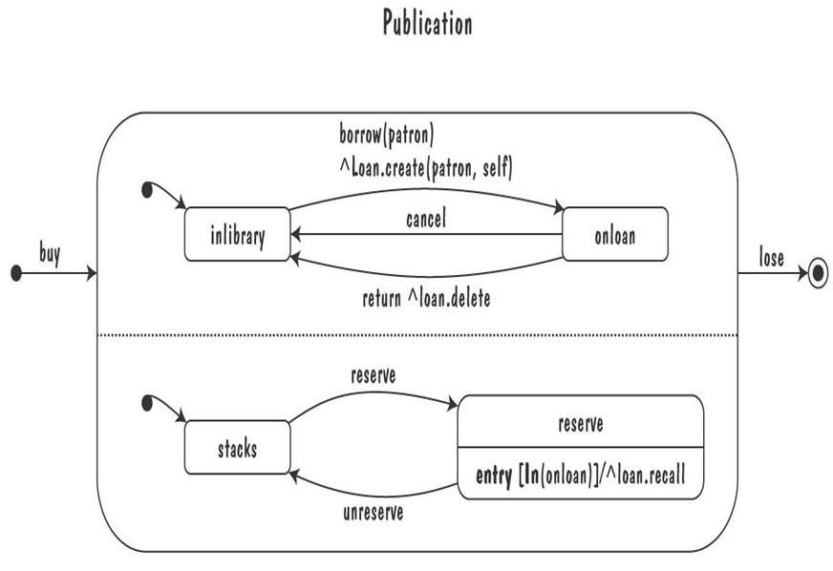
UML Statechart Diagram
The UML statechart diagram for the Publication class from the Library class model

Slide 29
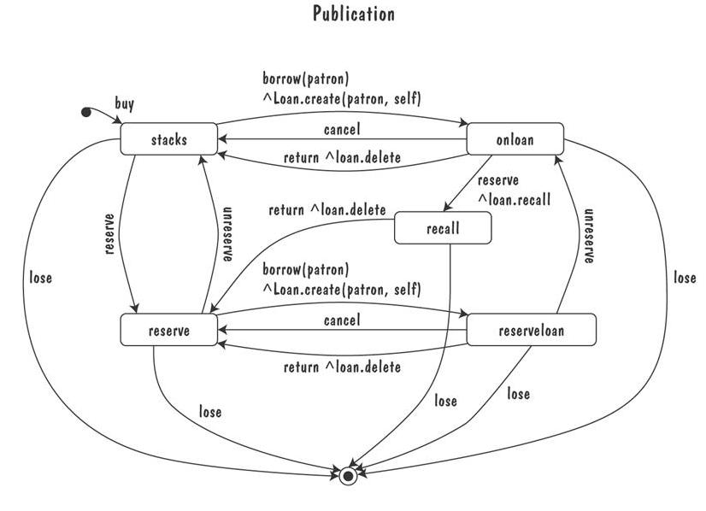
UML Statechart Diagram
An equivalent statechart for Publication class that does not make use of state hierarchy or concurrency
comparatively messy and and repetitive

Slide 30
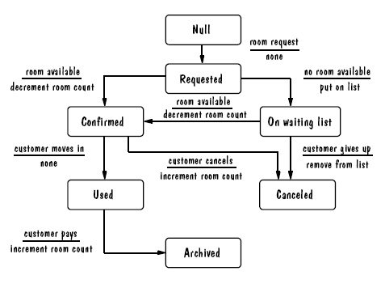
UML Statechart Diagram Example
The UML state diagram for Hotel Reservation

Slide 31
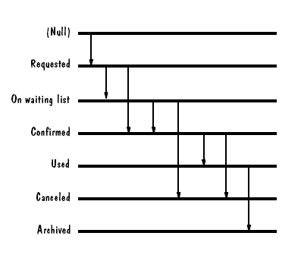
Fence Diagram

Slide 32
Special THANK FOR THE MATERIALS
Mr. Haroon Abdul Waheed
Prof. Zeeshan Ali Rana
Pfleeger’s Book slides from UCF
Software Fundamentals

